Slide 1

Data analytics Project
Ramya Movva
Sujith Siddi
Manas Rahul

Slide 2
Agenda
Company, Scenario, company Goals
Project goals & objectives & tools
Prepping the data
Visualizations
Answering the business questions
Recommendations
Final thoughts

Slide 3
Company, Scenario, company Goals
The Taproot Foundation helps nonprofits scale their efforts by connecting them to talented business professionals who volunteer their expertise to deliver high-impact pro bono service
The program data could be used to scale its own work, refining its long-standing Service Grant program and informing the design of its newest program, Taproot+.
Conversions on taprootplus platform data was added to the User Activity Data
In addition to the project data project categories has been added to know which category the project falls under and project inquiries to know users engagement on these projects

Slide 4
Project goals & objectives & tools
Analyze the real-world datasets and provide some insights that will contribute to the organization's mission and their specific needs.
Tools :
Tableau, Python Jupyter notebook, Microsoft Excel

Slide 5
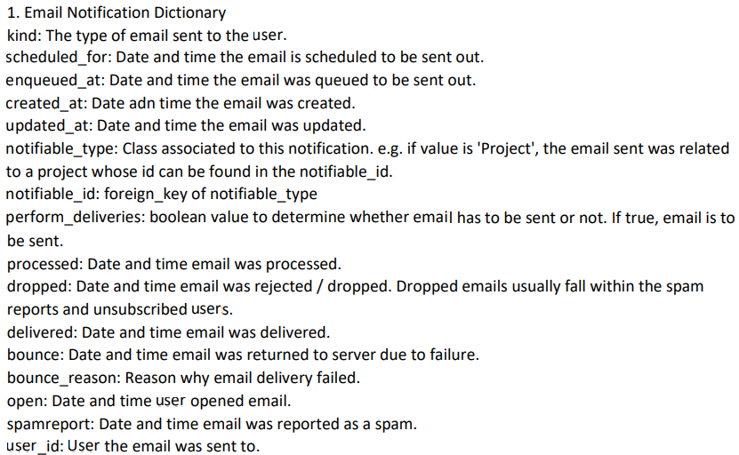
Data description & Quality
Conversions on taprootplus platform data was added to the User Activity Data
In addition to the project data project categories has been added to know which category the project falls under and project inquiries to know users engagement on these projects

Slide 6
Prepping the data
Collected all the csv files together and imported them into jupyter notebook
Using pandas, pre-processed the data by removing missing values. Dropped columns which have more than 70% of the data as missing data.
Consolidated all the years user activity data into one csv files by merging on the common fields.
Split the email column in email notification data so as to obtain email_type column and renamed the column kind to user_type.
Extracted the session ids from the Page column in the user activity dataset.

Slide 7
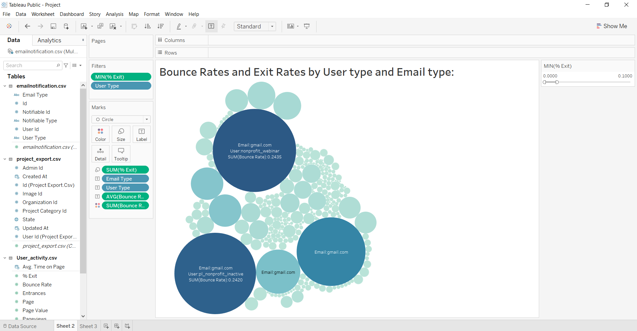
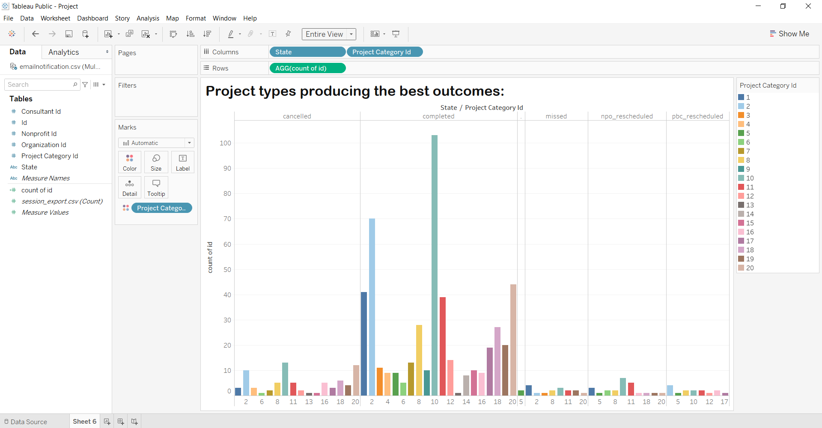
Visualizations & Insights that will help the company:
From the bubble graph, the top two bubbles with exit rates < 10% are nonprofit_webinar and pl_nonprofit_inactive with gmail.com as email_type
The average bounce rates for each of the user types are 24.35% and 24.20%
When analyzing project types with the best outcomes, the bar graph shows the outcomes of different project types based on the state of project.
As completed projects give the best outcome, project with id 10 has the longest bar and tend to produce the best outcomes in completed state.

Slide 8
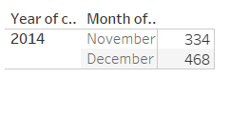
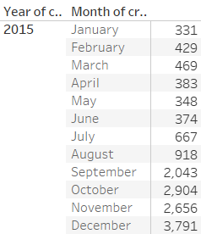
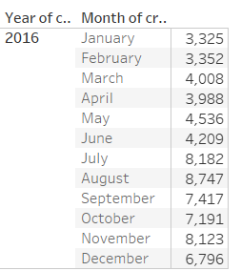
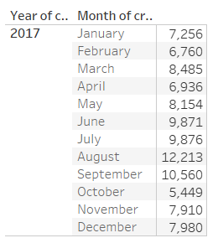
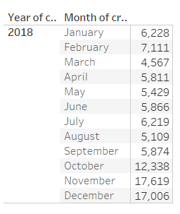
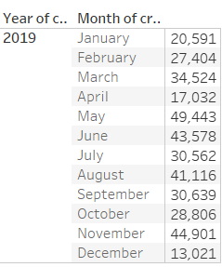
User activity data analysis:
The above tables show the user activity for the years 2014 to 2019
Of all the years, in the year 2019 the highest user activity is recorded with 49,443 sessions in the month of May
The least user activity was recorded in the year 2015 with 331 sessions in the month of January
In all the years except for 2019, the user activity has been increasing month to month
There are many fluctuations in the user activity in the year 2019
There has been steep increase in the user activity from the year 2018 to 2019. This can be attributed to mainly the growth of technology and internet.

Slide 9
Recommendations:
Based on the analytical results in the previous slides, these are the following recommendations or next steps to be taken:
The non-profit users webinar and inactive navigate away more often just after viewing one page. Focus should be kept on those user types and keep those non-profit users engaged to decrease the bounce rates
As we saw from the project recommendation data, the project with id 10 has more completion rate resulting in best outcomes. So the organization needs to focus on areas to improve why other projects are failing to reach the completion stage to give better outcomes.
Also, most number of sessions are generated for project 10. So identifying the causes and implementing the same solutions for other projects might help other projects for engagement with the users.
From the user activity data, we can see that more and more sessions are being generated rapidly. This indicates that there is a need for sophisticated data storage equipment and more compute power in the future to analyze the user activity.
And also there is a need to find out the reason for a sudden spike in the number of sessions.

Slide 10
Final thoughts
Difficult dataset
+ our underestimation of the project
____________________________________
= Limited capability
Notes:
Given the time constraints and our own priorities, we dramatically underestimated this project's depth,
The data definitely had a lot of columns that didn't make sense at first glance, so that added to our struggle of finding relationships
but we did our best with the small time we were able to somehow work with.

Slide 11
Thank you for listening

Slide 12
appendix

Slide 13
Prep details
Data Preparation:
1. Data Cleaning
Handling missing values
Dropping irrevelant columns
Merging datasheets
Converting data into a consistent datatype
2.Feature Selection
Choosing columns that are useful for the analysis
3.Establishing Relationships:
Using tableau, established relationships between different data sources on user ids and session ids

